Slide 1




FINLEARN
AGILE AVENGERS
FINAL DEMO
Notes:
Aditya/Adam : 20 Sec

Slide 2

Background
1
TABLE OF CONTENTS
Demo
2
Process
3
Software Architecture
4
Technical
5
FINLEARN
Notes:
Aditya/Adam : 20 Sec

Slide 3

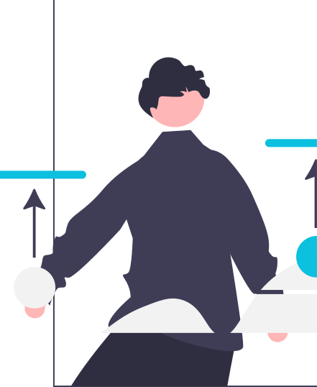
WHAT ARE WE TRYING TO SOLVE?
IMPROVE FINANCIAL LITERACY AMONG YOUNG ADULTS
Lack of Financial Literacy:
Complex terms and concepts in finance
Too many sources of information
Inaccurate and conflicting advice
Fear of making mistakes:
Avoid risk even favourable
Avoid investing
Uninformed decisions due to peer pressure
Disengaging traditional education:
Textbooks are dull
All theoretical learnings are eventually forgotten if not applied
Very few avenues of liability-free practical application
FINLEARN
Notes:
Aditya: 1 min

Slide 4
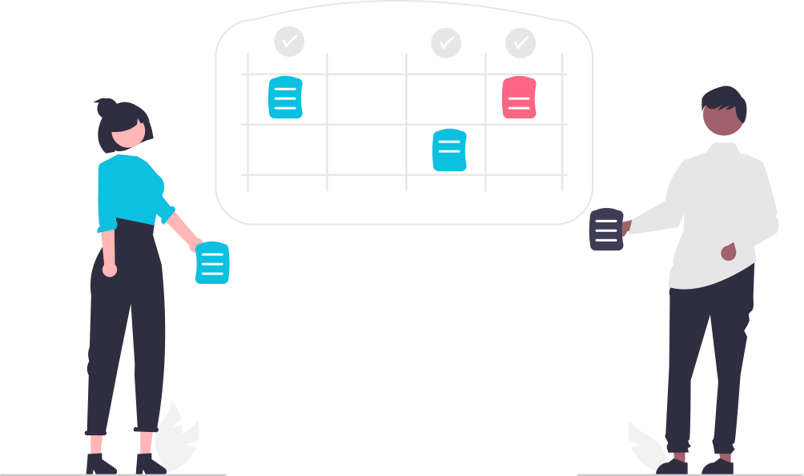
OUR SOLUTION
FINLEARN
FinLearn is
a financial literacy platform
for young adults
who are ready to take a step towards an independent lifestyle.
FinLearn offers
an all-in-one
zero-liability
learning solution
FinLearn does this by providing
short lessons in the form of videos and articles
a sandbox environment to test theoretical learnings
FINLEARN
Notes:
Aditya: 1 min
+
Demo: 4-5 min
- Rahul: Landing+Signup+ SignIn+Favourite+Learning
- Aryan: Research + Trading

Slide 5

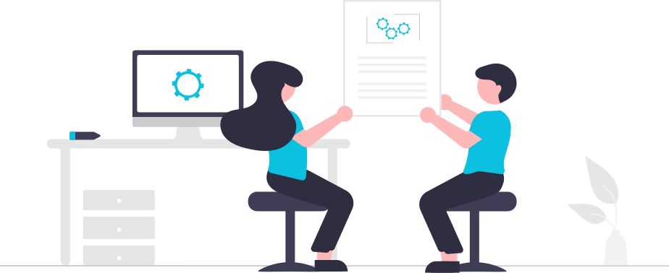
1
Communicate needs and tasks using Discord, Zoom, and in-person discussions. Document decisions on Confluence.
PROCESS
EXPRESS
AND IDEATE
A procedure for how we worked to accomplish this task
2
All stories and tasks were logged on JIRA and assigned to members based on their knowledge and interest.
DEFINE AND ASSIGN
We conducted daily stand-ups along with sprint reviews and sprint planning meetings once a sprint.
3
We used Git for version control and GitHub for source control and reviews.
WORK AND REVIEW
4
After a feature met the acceptance criteria, the branch was merged to develop and the ticket was moved to Done. All features in the sprint were merged at the end to the main.
PRS AND COMPLETION
FINLEARN
Notes:
Aryan: 2 minutes

Slide 6






SOFTWARE ARCHITECHTURE
FINLEARN
Client
Server
Database
Notes:
Shashwat: 2 minutes

Slide 7
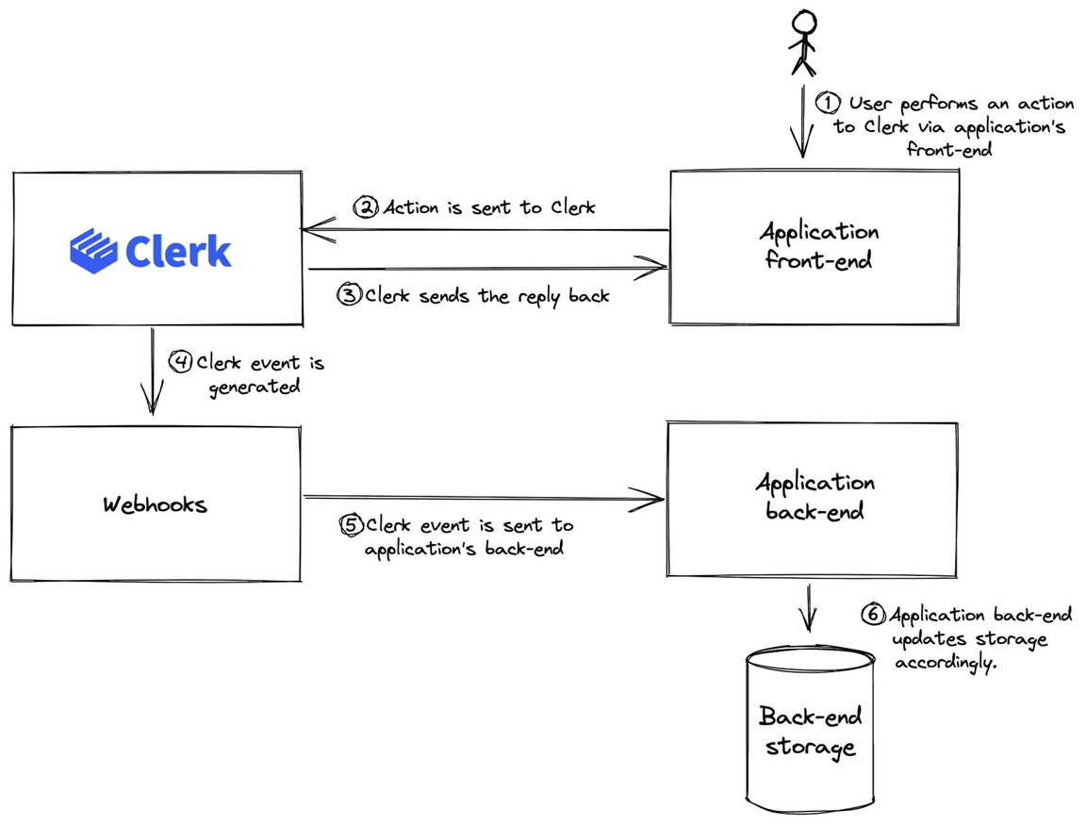
TECHNICAL
Webhooks
To keep our database in sync with users being registered on Clerk, we make use of Webhook
Webhooks allow Clerk to inform us about specific events
FINLEARN
Notes:
Shawn: 45 sec

Slide 8
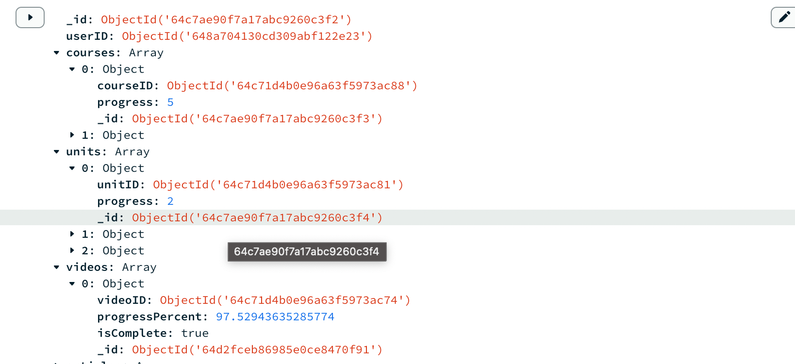
TECHNICAL
Video Progress Tracking
Example Object Used to track Learning Progress
Firstly, our initial choice of the learning progress schema closely resembled an entity-relationship schema commonly used in SQL databases. This led to a need for a complex populating logic
On the front-end we needed a timer to track, the video's progress. This timer was designed to trigger a specific action every 5 seconds of active video watching by a user.
FINLEARN
Notes:
Technical - Video Progress - Rahul: 1 minute

Slide 9


INDIVIDUAL CONTRIBUTIONS
Adam
Aditya
Aryan
Balraj
Rahul
Shashwat
Shawn
FINLEARN
Notes:
Individual Contributions:
7 minutes

